Slide 1
Sacred Lands,
Poisoned People
a presentation by
Gordon Edwards Ph.D.
and Robert Del Tredici
featuring the photographs of Robert Del Tredici
Canadian Coalition for Nuclear Responsibility
www.ccnr.org
Notes:
The Canadian Coalition was

Slide 2
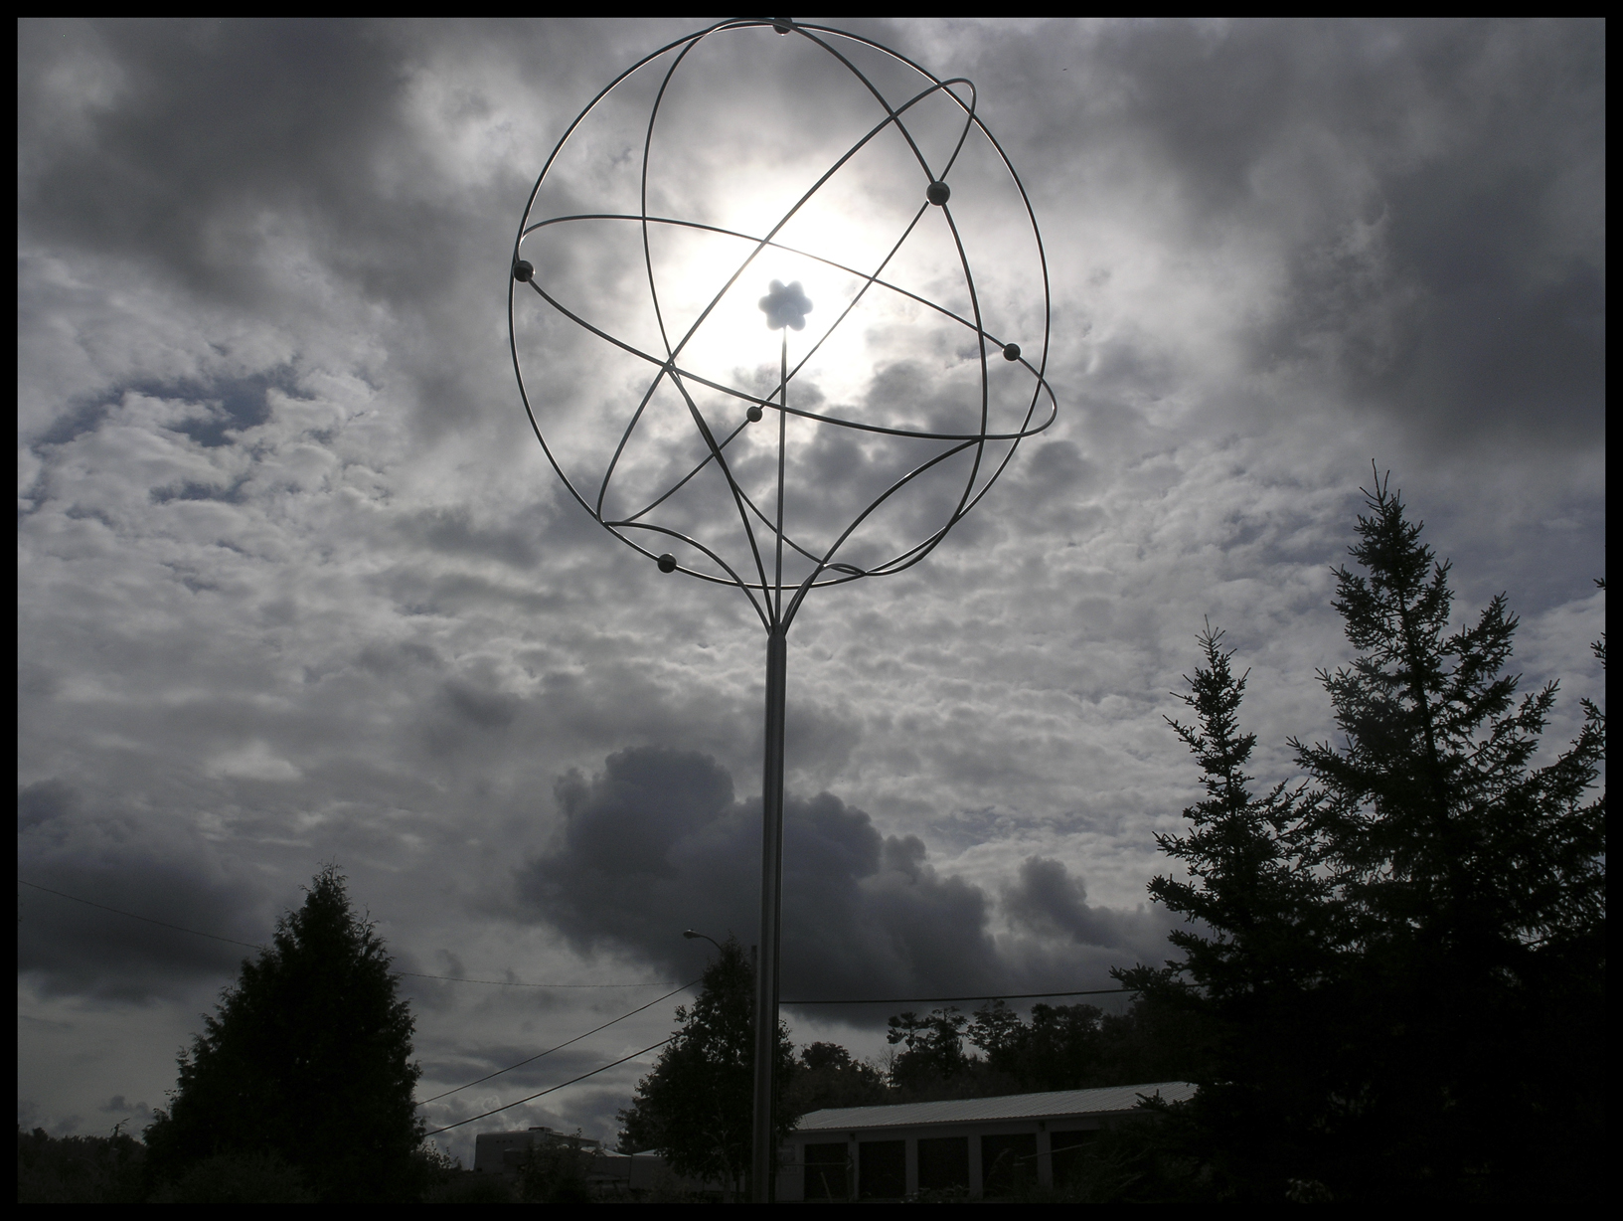
Model of Uranium Atom

Slide 3
Model of Uranium Atom
Uranium is the key element for all nuclear technology

Slide 4
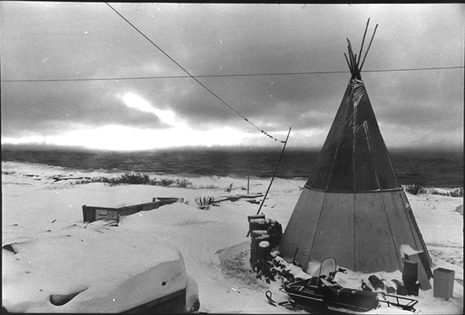
Teepee at Deline

Slide 5
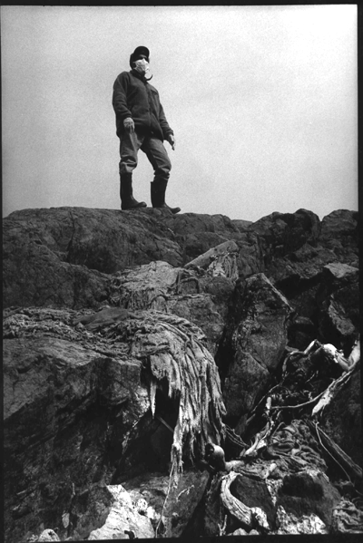
Abandoned Ore Sacks

Slide 6
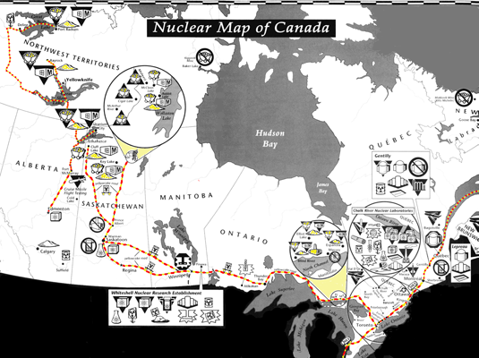
Yellowcake Road
The Yellowcake Road (Canada)

Slide 7
Uranium and its Uses
www.ccnr.org
Notes:
The Canadian Coalition was

Slide 8
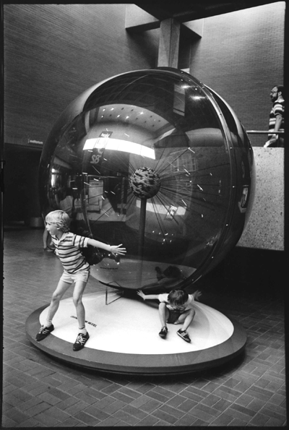
Model of Uranium Atom

Slide 9
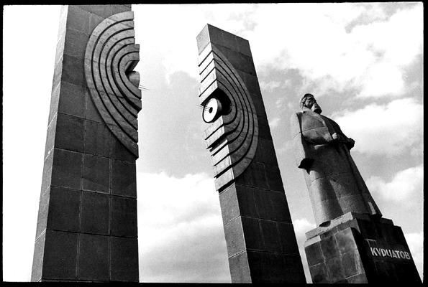
Splitting of the Atom

Slide 10
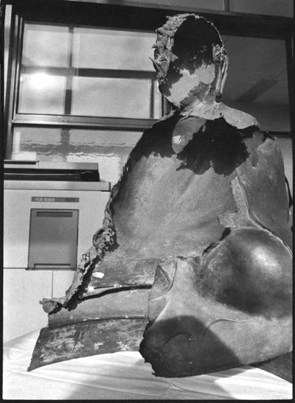
Hiroshima Buddha

Slide 11
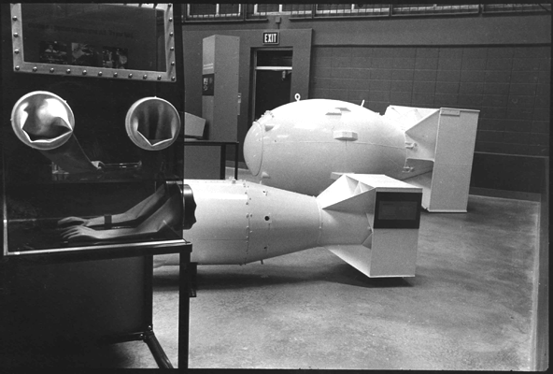
Fat Man and Little Boy

Slide 12
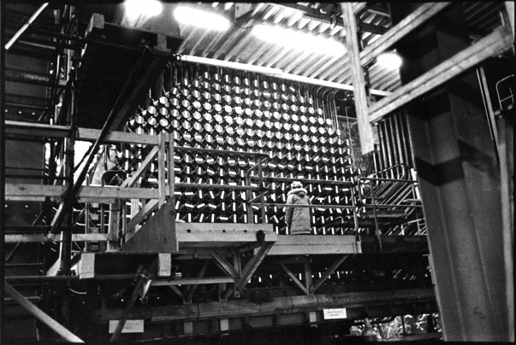
Face of the CANDU

Slide 13
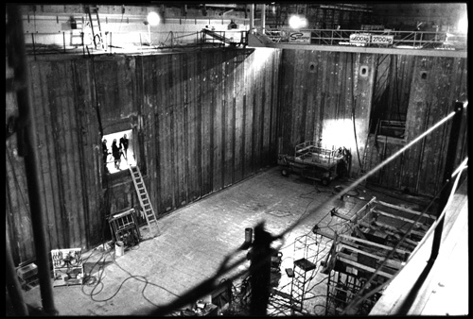
Empty Spent Fuel Pool

Slide 14
Uranium and its Dangers
www.ccnr.org
Notes:
The Canadian Coalition was

Slide 15
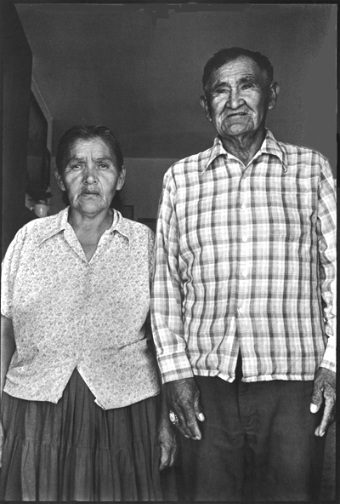
Navajo Miner

Slide 16
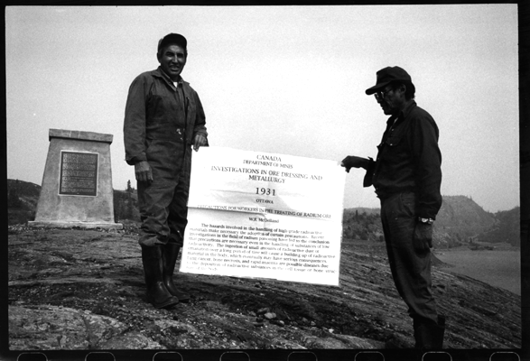
1931 document

Slide 17
Test of 1931 document
CANADA
DEPARTMENT OF MINES
INVESTIGATIONS IN ORE DRESSING AND METALLURGY
1931
OTTAWA
PRECAUTIONS FOR WORKERS IN THE
TREATMENT OF RADIUM ORES
W. R. McClelland
Recent investigations in the field of radium poisoning have led to the conclusion that precautions are necessary even in the handling of substances of low radioactivity. The ingestion of small amounts of radioactive dust or emanation over a long period of time may have serious consequences: lung cancer, bone necrosis and rapid anemia are possible diseases due to deposition of radioactive substances in the cell tissue or bone structure of the body.

Slide 18
Test of 1931 document
CANADA
DEPARTMENT OF MINES
INVESTIGATIONS IN ORE DRESSING AND METALLURGY
1931
OTTAWA
PRECAUTIONS FOR WORKERS IN THE
TREATMENT OF RADIUM ORES
W. R. McClelland
Recent investigations in the field of radium poisoning have led to the conclusion that precautions are necessary even in the handling of substances of low radioactivity. The ingestion of small amounts of radioactive dust or emanation over a long period of time may have serious consequences: lung cancer, bone necrosis and rapid anemia are possible diseases due to deposition of radioactive substances in the cell tissue or bone structure of the body.

Slide 19
Test of 1931 document
CANADA
DEPARTMENT OF MINES
INVESTIGATIONS IN ORE DRESSING AND METALLURGY
1931
OTTAWA
PRECAUTIONS FOR WORKERS IN THE
TREATMENT OF RADIUM ORES
W. R. McClelland
Recent investigations in the field of radium poisoning have led to the conclusion that precautions are necessary even in the handling of substances of low radioactivity. The ingestion of small amounts of radioactive dust or emanation over a long period of time may have serious consequences: lung cancer, bone necrosis and rapid anemia are possible diseases due to deposition of radioactive substances in the cell tissue or bone structure of the body.

Slide 20
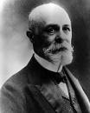
Henri Becquerel 1896

Slide 21
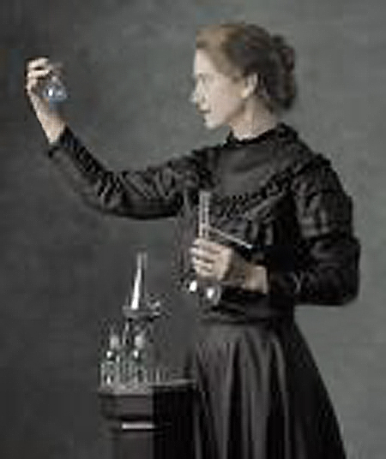
Ball of Plutonium
Marie Curie 1898

Slide 22
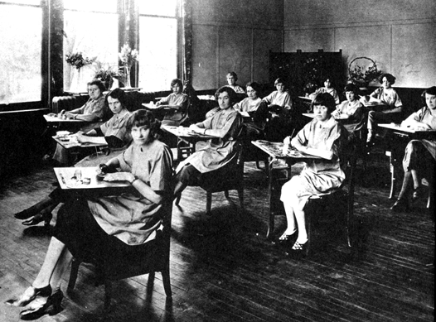
Radium dial painters
Dial Painters 1920
Radium-226

Slide 23
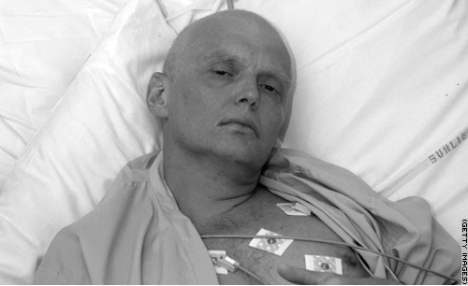
Alexander Litvinenko 2006
Polonium-210

Slide 24
Los Alamos National Laboratory's Chemistry Division
http://periodic.lanl.gov/elements/84.html
Polonium-210
Weight by weight
it is about 250 billion times
as toxic as hydrogen cyanide.

Slide 25
American Health Physics Society
Polonium-210
… is probably the cause of
up to 90 percent of the deaths
attributed to tobacco.

Slide 26
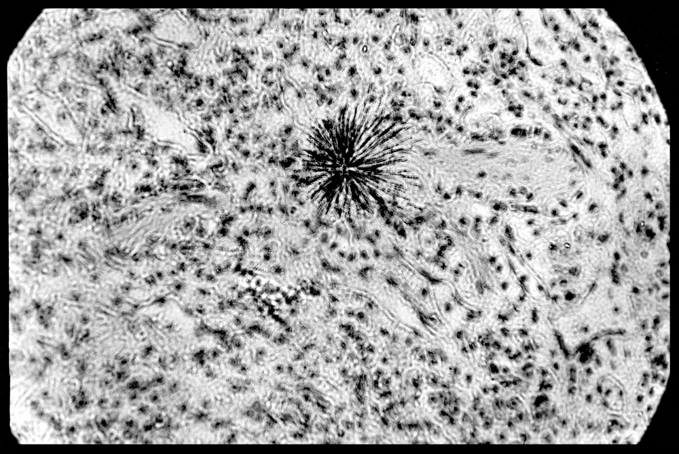
Alpha Radiation

Slide 27
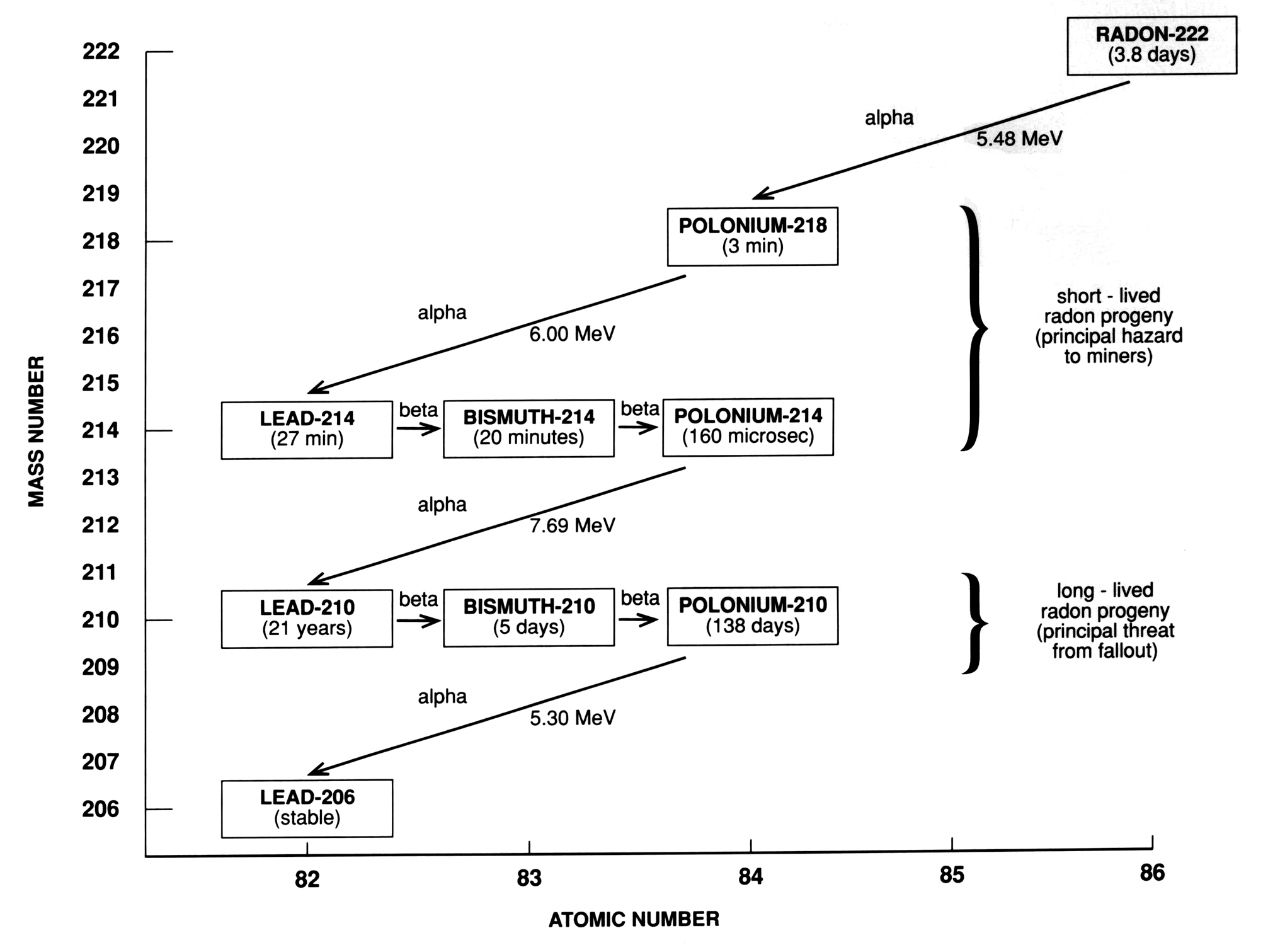
Radon Progeny (chart)
Although radon is a gas . . .
its byproducts are solids and
lodge in the lungs . . .
Radon Progeny (chart)
. . . in fact 85% of the lung dose
is from alpha-emitting polonium

Slide 28
Uranium and its Legacy
www.ccnr.org
Notes:
The Canadian Coalition was

Slide 29
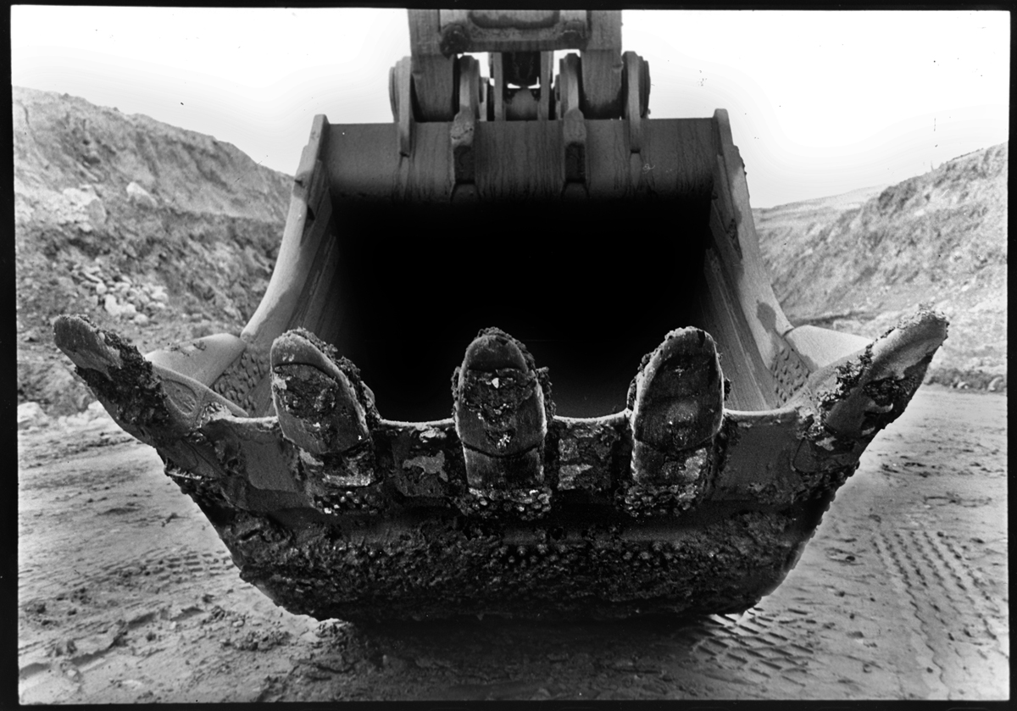

Slide 30
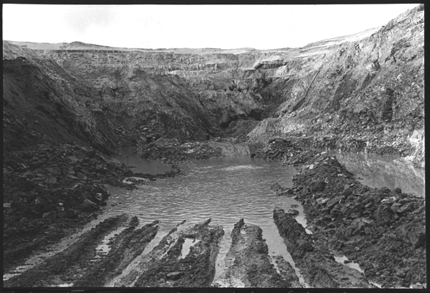
Key Lake Mine

Slide 31
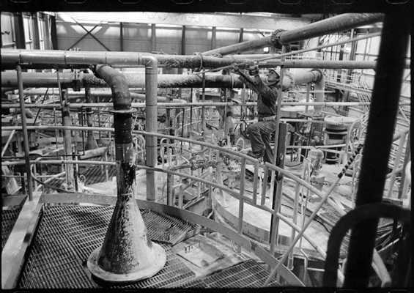
Uranium Mill

Slide 32
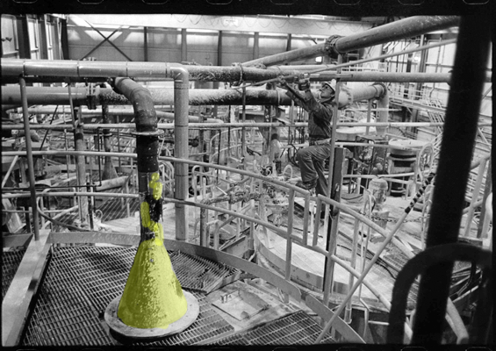
Uranium Mill

Slide 33
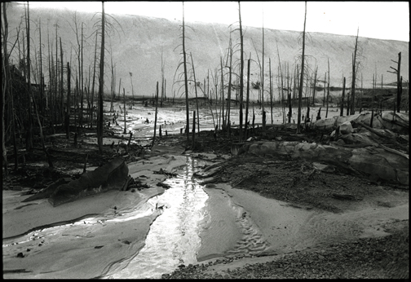

Slide 34
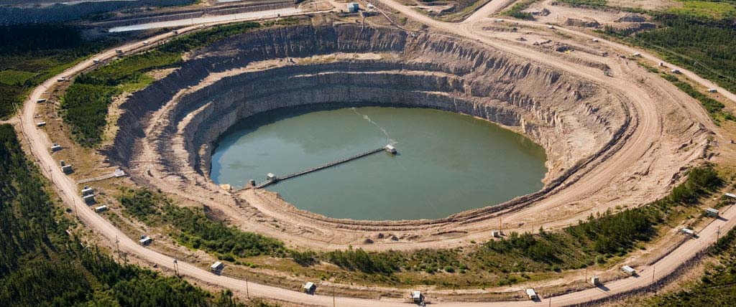
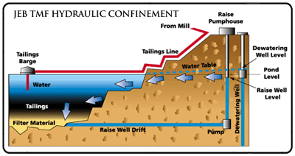
Tailings disposal in
JEB open pit, McClean Lake,
Saskatchewan, Canada
(Areva NC)
Notes:
An even lower-cost version of pervious surround disposal is pursued by Areva/Cogéma in the former JEB open pit at the McClean Lake mine in Saskatchewan, Canada: There is no artificial pervious layer; the surrounding rock is to serve as pervious surround.

Slide 35
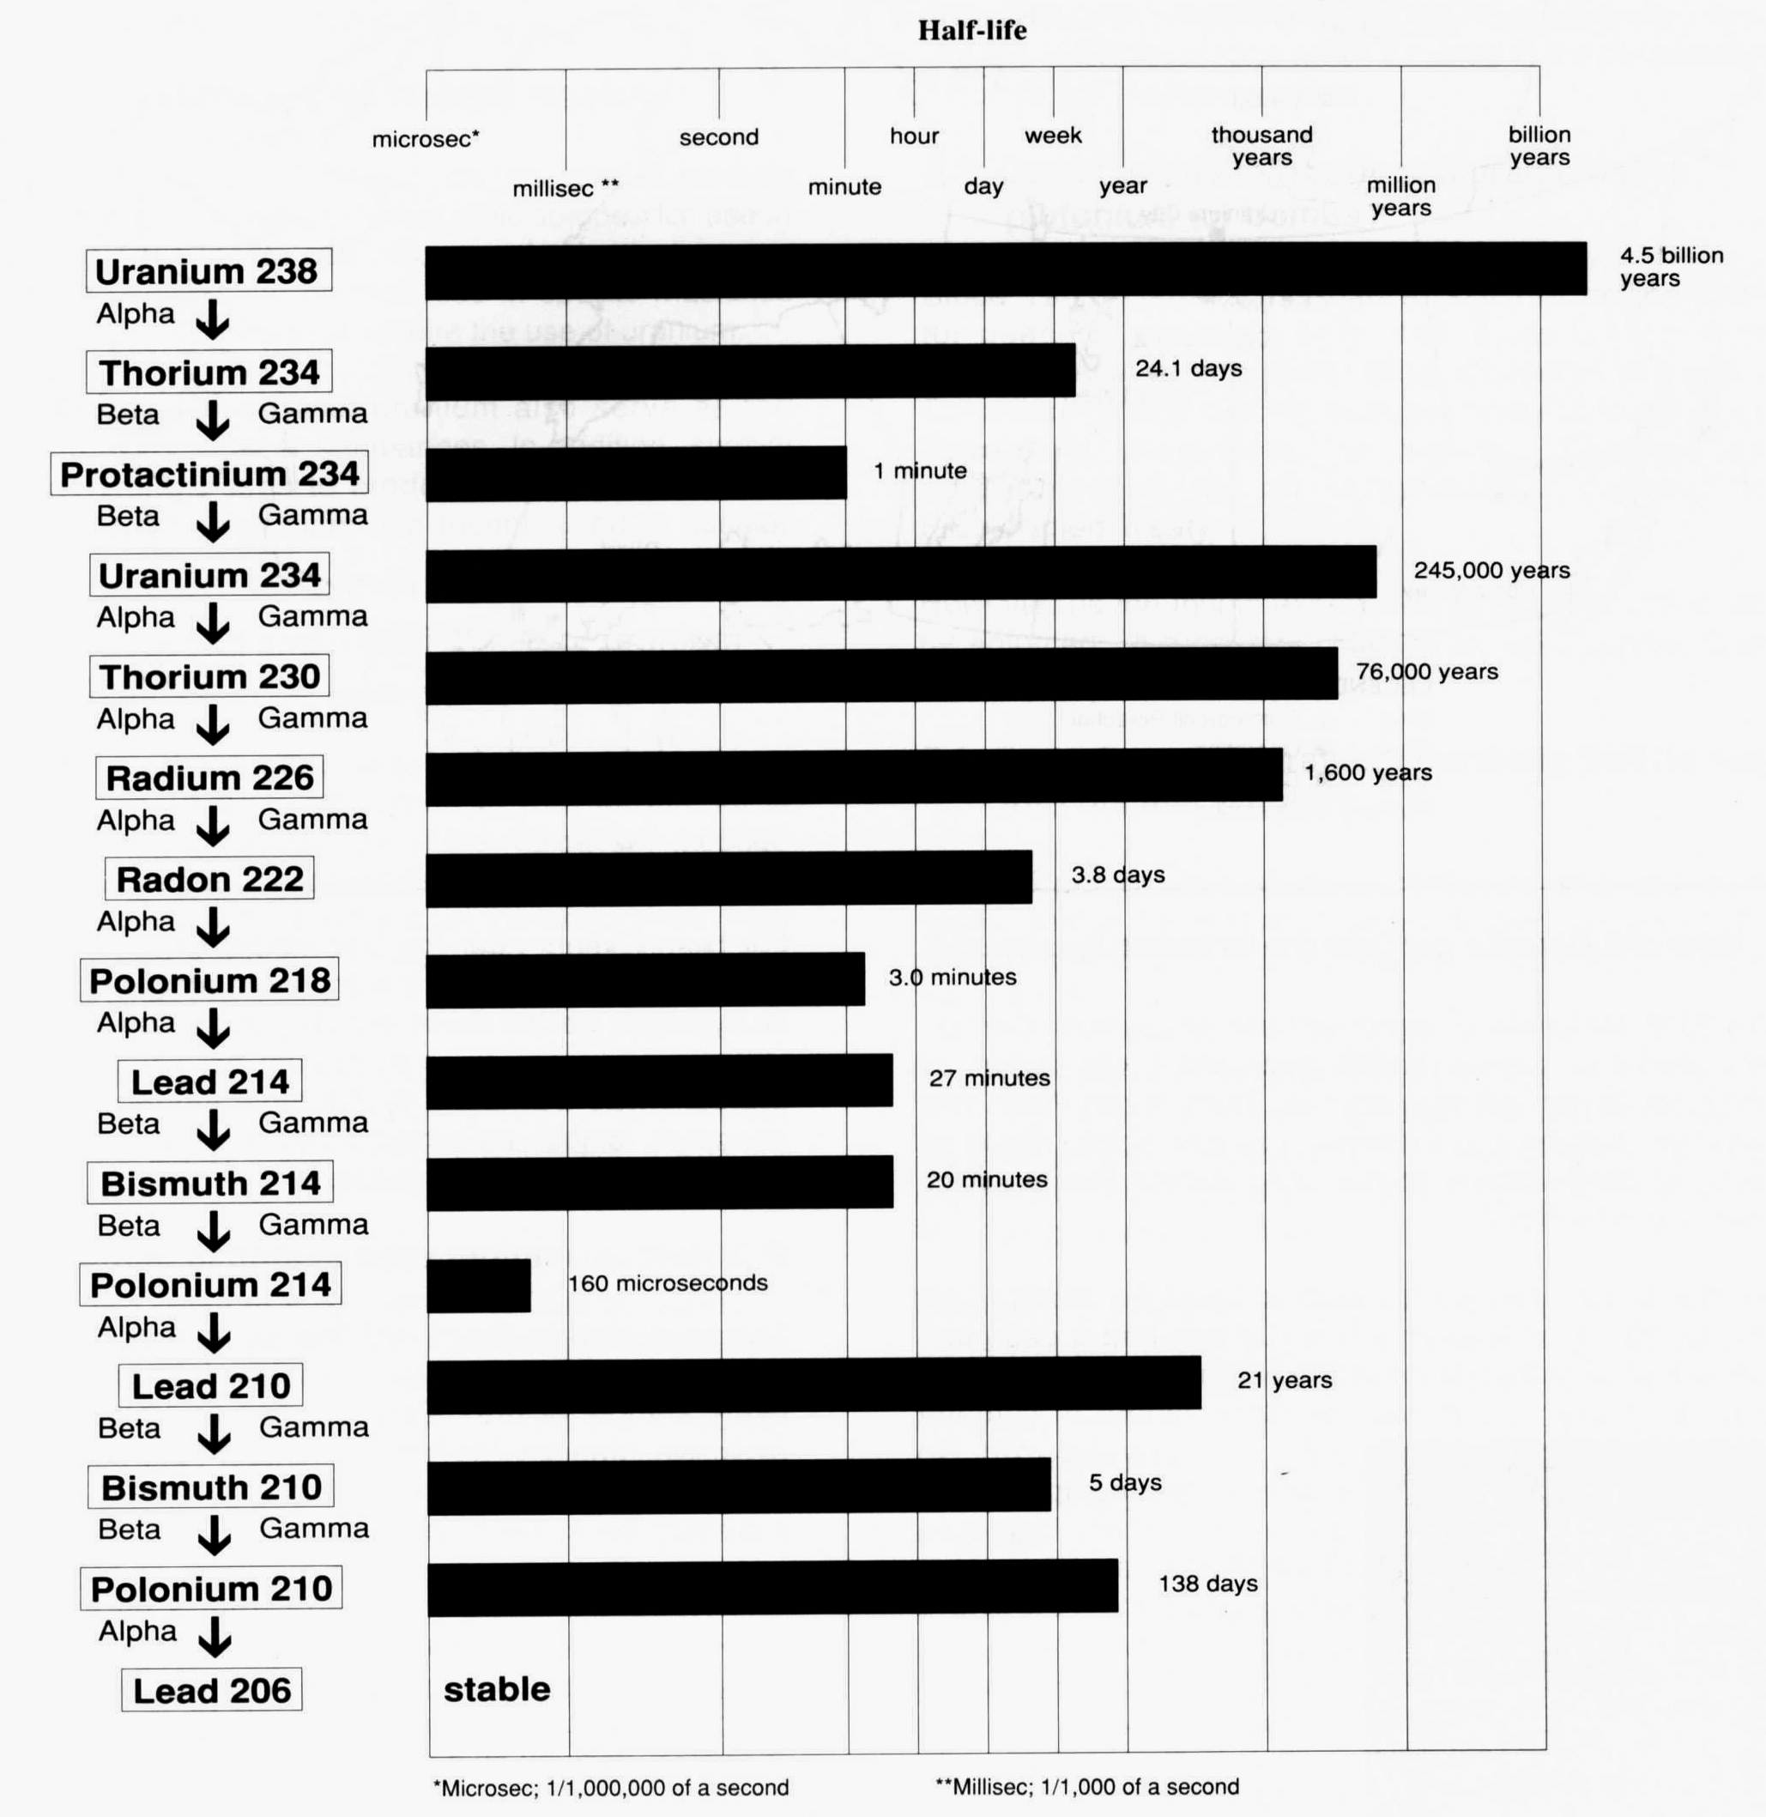
Uranium Decay Chain
.

Slide 36
Uranium Decay Chain
.
.
.
.

Slide 37
Groundwater
Notes:
The hazards from the tailings persist after termination of the mining activities
- gamma (and beta-) radiation is of concern only immediately on the deposit

Slide 38
Groundwater
Notes:
Dust is being blown to the surroundings; it contains radioactive and toxic constituents, such as radium-226 and arsenic

Slide 39
Groundwater
Notes:
Radon gas is being transported over large distances. New radon is continuously formed by decay of radium-226; some fraction of the radon is being released and dispersed over large areas.

Slide 40
Uranium Mill Tailings Hazards
rayonnement
gamma
Gamma radiation
Résidus
miniers
Groundwater
Notes:
Seepage release, containing radioactive and toxic constituents

Slide 41
Cleaning Up Sites Contaminated with Radioactive Materials: International Workshop Proceedings
(2009) Development, Security, and Cooperation (DSC)
Lands Damaged as a Result of Uranium Ore
Mining Operations in the Russian Federation
The operations of uranium ore mining and processing enterprises inevitably contaminate the environment with solid, liquid, and
gaseous wastes, which are the most voluminous within the nuclear fuel cycle industries and, despite their relatively low activity level, significantly contribute to the radiation hazard facing the population.
Beginning from the time large-scale uranium ore geological prospecting and mining began in the USSR in 1945, nine industrial complexes were built on the territories of six Soviet republics. The complexes now operate as production facilities in the Newly Independent States. The total land area damaged by their production activities is 80,500 ha, and about 220,000 ha may be affected eventually by radioactive products transferred by air streams, surface water flows, and so forth.
V. P. Karamushka and V. V. Ostroborodov, All-Russian Research,
Design, and Surveying Institute of Industrial Technology (VNIPIPT)

Slide 42
Cleaning Up Sites Contaminated with Radioactive Materials: International Workshop Proceedings
(2009) Development, Security, and Cooperation (DSC)
Lands Damaged as a Result of Uranium Ore
Mining Operations in the Russian Federation
The operations of uranium ore mining and processing enterprises inevitably contaminate the environment with solid, liquid, and
gaseous wastes, which are the most voluminous within the nuclear fuel cycle industries and, despite their relatively low activity level, significantly contribute to the radiation hazard facing the population.
Beginning from the time large-scale uranium ore geological prospecting and mining began in the USSR in 1945, nine industrial complexes were built on the territories of six Soviet republics. The complexes now operate as production facilities in the Newly Independent States. The total land area damaged by their production activities is 80,500 ha, and about 220,000 ha may be affected eventually by radioactive products transferred by air streams, surface water flows, and so forth.
V. P. Karamushka and V. V. Ostroborodov, All-Russian Research,
Design, and Surveying Institute of Industrial Technology (VNIPIPT)

Slide 43
Cleaning Up Sites Contaminated with Radioactive Materials: International Workshop Proceedings
(2009) Development, Security, and Cooperation (DSC)
Lands Damaged as a Result of Uranium Ore
Mining Operations in the Russian Federation
The operations of uranium ore mining and processing enterprises
inevitably contaminate the environment with solid, liquid, and
gaseous wastes, which are the most voluminous within the nuclear fuel cycle industries and, despite their relatively low activity level,
significantly contribute to the radiation hazard facing the population.
Beginning from the time large-scale uranium ore geological prospecting and mining began in the USSR in 1945, nine industrial complexes were built on the territories of six Soviet republics. The complexes now operate as production facilities in the Newly Independent States. The total land area damaged by their production activities is 80,500 ha, and about 220,000 ha may be affected eventually by radioactive products transferred by air streams, surface water flows, and so forth.
V. P. Karamushka and V. V. Ostroborodov, All-Russian Research,
Design, and Surveying Institute of Industrial Technology (VNIPIPT)

Slide 44
Cleaning Up Sites Contaminated with Radioactive Materials: International Workshop Proceedings
(2009) Development, Security, and Cooperation (DSC)
Lands Damaged as a Result of Uranium Ore
Mining Operations in the Russian Federation
The operations of uranium ore mining and processing enterprises
inevitably contaminate the environment with solid, liquid, and
gaseous wastes, which are the most voluminous within the nuclear fuel cycle industries and, despite their relatively low activity level,
significantly contribute to the radiation hazard facing the population.
Beginning from the time large-scale uranium ore geological prospecting and mining began in the USSR in 1945, nine industrial complexes were built on the territories of six Soviet republics. The complexes now operate as production facilities in the Newly Independent States. The total land area damaged by their production activities is 80,500 ha, and about 220,000 ha may be affected eventually by radioactive products transferred by air streams, surface water flows, and so forth.
V. P. Karamushka and V. V. Ostroborodov, All-Russian Research,
Design, and Surveying Institute of Industrial Technology (VNIPIPT)

Slide 45
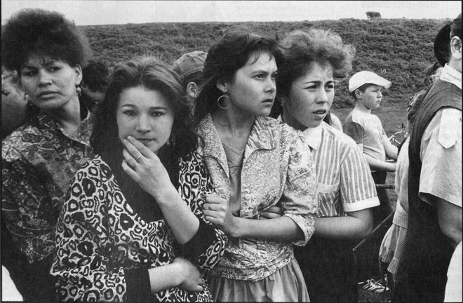
Maids of Muslyumovo

Slide 46
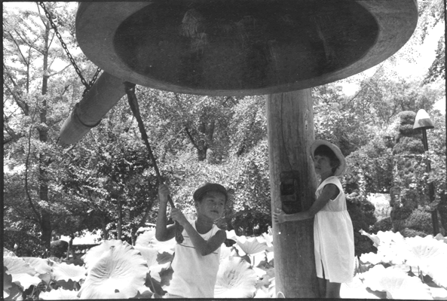

Slide 47
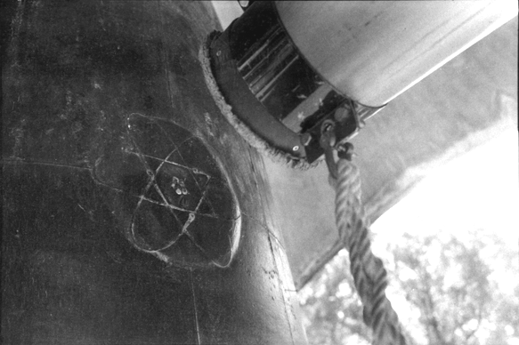

Slide 48
Uranium:
A Medical Epilogue
www.ccnr.org
Notes:
The Canadian Coalition was

Slide 49
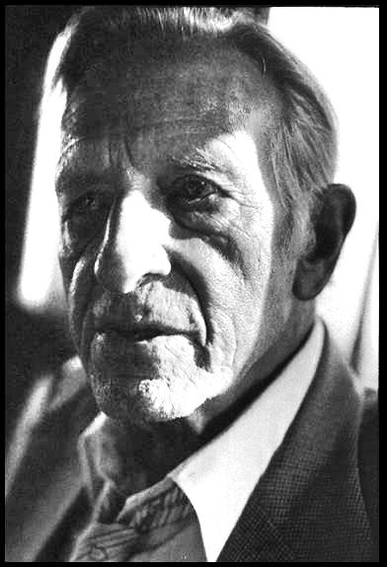
Pat Lawson

Slide 50
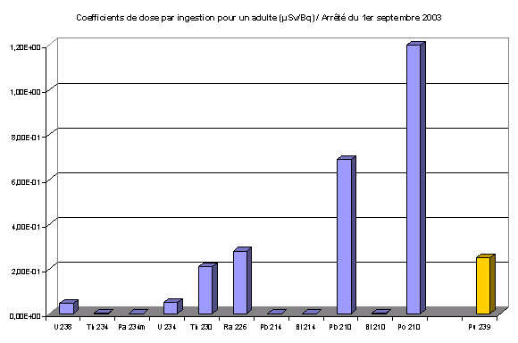
Dose Coefficients for an adult (ingestion) in microSieverts per Becquerel (official figures from EURATOM 96/29)
Polonium 210
Lead 210
Radium 226
Plutonium 239
Uranium 238

Slide 51
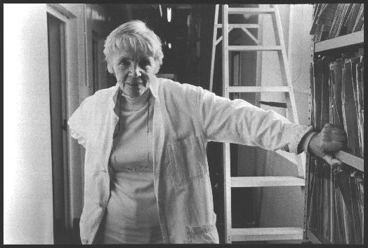
Alice Stewart

Slide 52
Biomarker Monitoring of a Population Residing near Uranium Mining Activities. William W. Au et al.
Environmental Health Perspectives Volume 103, Number 5, May 1995
http://ehp.niehs.nih.gov/members/1995/103-5/au-full.htm
Researchers from Dept of Preventive Medicine & Community Health and Dept of Radiation Therapy, Univ of Texas Medical Branch, Galveston, TX 77555-1110 USA
We found that individuals who resided near uranium mining operations had a higher mean frequency of cells with chromosome aberrations and higher deletion frequency but lower dicentric frequency than the reference group, although the difference was not statistically significant. After cells were challenged by exposure to gamma-rays, the target population had a significantly higher frequency of cells with chromosome aberrations and deletion frequency than the reference group. The latter observation is indicative of abnormal DNA repair response in the target population.

Slide 53
Biomarker Monitoring of a Population Residing near Uranium Mining Activities. William W. Au et al.
Environmental Health Perspectives Volume 103, Number 5, May 1995
http://ehp.niehs.nih.gov/members/1995/103-5/au-full.htm
Researchers from Dept of Preventive Medicine & Community Health and Dept of Radiation Therapy, Univ of Texas Medical Branch, Galveston, TX 77555-1110 USA
We found that individuals who resided near uranium mining operations had a higher mean frequency of cells with chromosome aberrations and higher deletion frequency but lower dicentric frequency than the reference group, although the difference was not statistically significant. After cells were challenged by exposure to gamma-rays, the target population had a significantly higher frequency of cells with chromosome aberrations and deletion frequency than the reference group. The latter observation is indicative of abnormal DNA repair response in the target population.

Slide 54
Biomarker Monitoring of a Population Residing near Uranium Mining Activities. William W. Au et al.
Environmental Health Perspectives Volume 103, Number 5, May 1995
http://ehp.niehs.nih.gov/members/1995/103-5/au-full.htm
Researchers from Dept of Preventive Medicine & Community Health and Dept of Radiation Therapy, Univ of Texas Medical Branch, Galveston, TX 77555-1110 USA
We found that individuals who resided near uranium mining operations had a higher mean frequency of cells with chromosome aberrations and higher deletion frequency but lower dicentric frequency than the reference group, although the difference was not statistically significant. After cells were challenged by exposure to gamma-rays, the target population had a significantly higher frequency of cells with chromosome aberrations and deletion frequency than the reference group. The latter observation is indicative of abnormal DNA repair response in the target population.

Slide 55
Biomarker Monitoring of a Population Residing near Uranium Mining Activities. William W. Au et al.
Environmental Health Perspectives Volume 103, Number 5, May 1995
http://ehp.niehs.nih.gov/members/1995/103-5/au-full.htm
Researchers from Dept of Preventive Medicine & Community Health and Dept of Radiation Therapy, Univ of Texas Medical Branch, Galveston, TX 77555-1110 USA
We found that individuals who resided near uranium mining operations had a higher mean frequency of cells with chromosome aberrations and higher deletion frequency but lower dicentric frequency than the reference group, although the difference was not statistically significant. After cells were challenged by exposure to gamma-rays, the target population had a significantly higher frequency of cells with chromosome aberrations and deletion frequency than the reference group. The latter observation is indicative of abnormal DNA repair response in the target population.

Slide 56
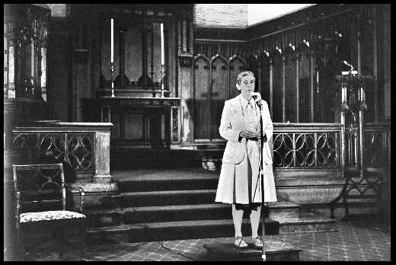
Rosalie Bertell

Slide 57
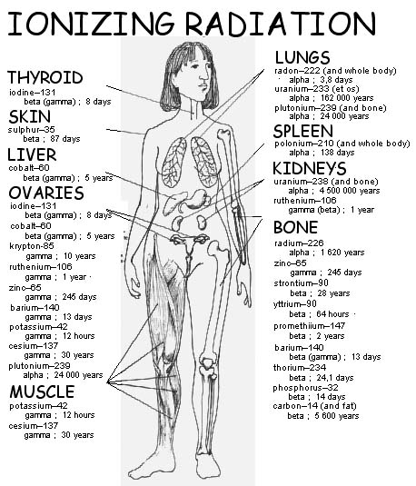
Rad in body

Slide 58
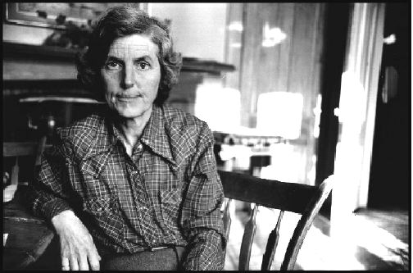
Pat Lawson

Slide 59
Large populations are needed for statistical significance
Long-term followup is needed due to latency period
Accurate Estimation of Radiation Dose is needed for correlation
Target Organs / Diseases must be known or determined
Confounding factors must be dealt with or eliminated
Morbidity versus mortality has to be carefully considered
Need for a birth defects / spontaneous abortion registry
Canadian Coalition for Nuclear Responsibility
www.ccnr.org
Notes:
My name is Gordon Edwards.
I graduated from the University of Toronto with a
Gold Medal in Mathematics and Physics.
I was shocked when I discovered that nuclear power plants
Routinely produce highly radioactive wastes which remain
Dangerous for hundreds of thousands of years.
In 1975 I was one of a group of thirty people who created
The Canadian Coalition for Nuclear Responsibility.

Slide 60
The End
Canadian Coalition for Nuclear Responsibility
www.ccnr.org
Notes:
My name is Gordon Edwards.
I graduated from the University of Toronto with a
Gold Medal in Mathematics and Physics.
I was shocked when I discovered that nuclear power plants
Routinely produce highly radioactive wastes which remain
Dangerous for hundreds of thousands of years.
In 1975 I was one of a group of thirty people who created
The Canadian Coalition for Nuclear Responsibility.

Slide 62
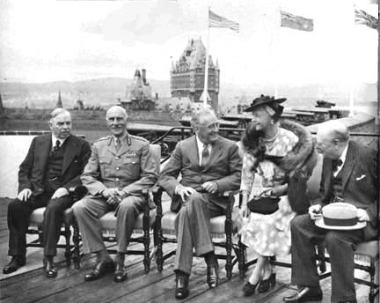
Quebec Agreement

Slide 63
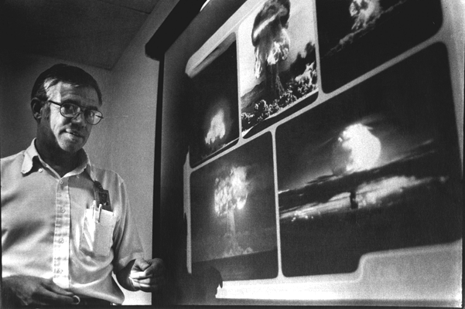
Mushroom Clouds

Slide 64
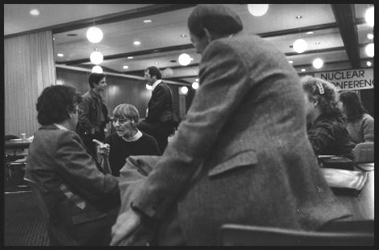
Maisie Shiell

Slide 65
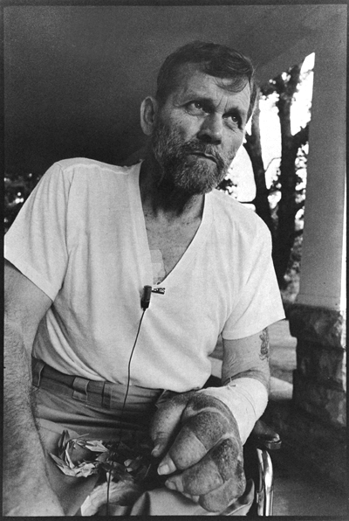
John Smitherman

Slide 66
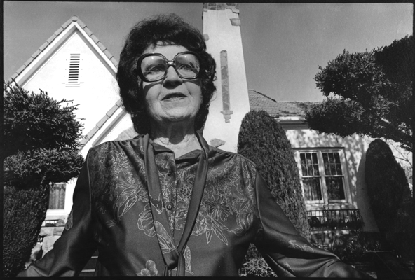
Irma Thomas

Slide 67
Groundwater
Notes:
Settlement on top of the tailings must be prevented (in the long term!) for the serious radiation hazard connected to it.

Slide 69
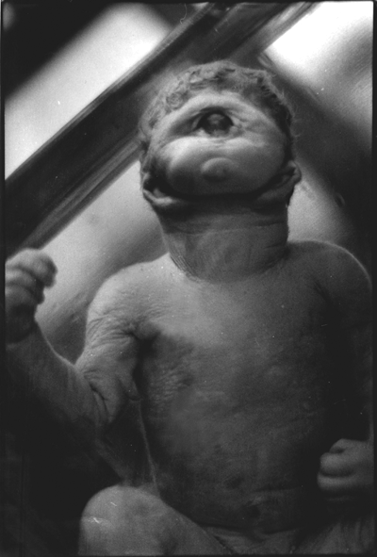
Cyclops

Slide 70
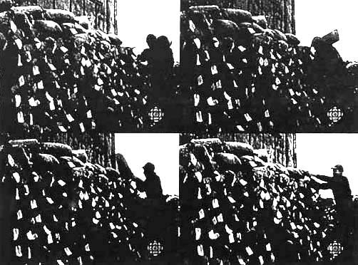
Ore Carriers

Slide 71
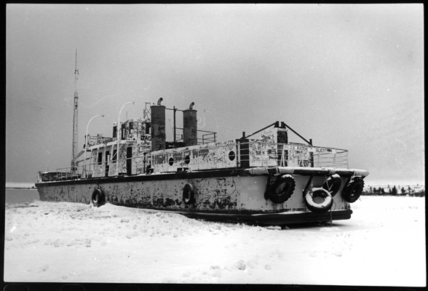
Radium Gilbert

Slide 72
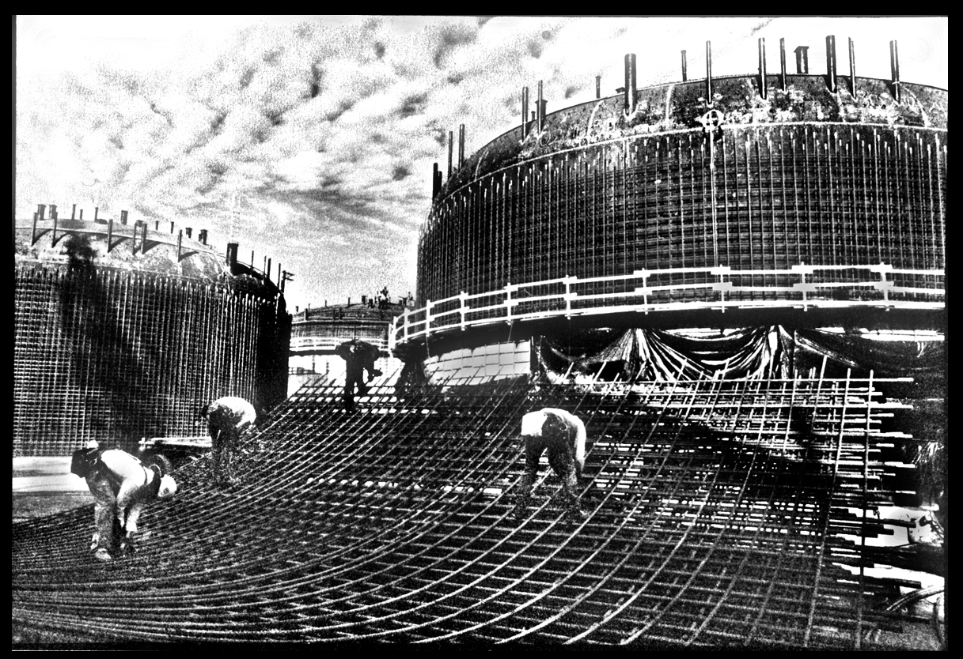

Slide 73
Radium dial painters

Slide 74
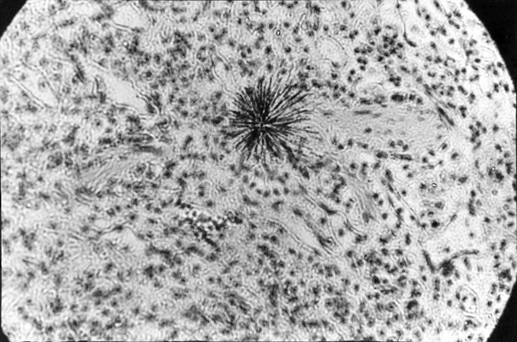
Alpha Particles

Slide 75
Four Types of Atomic Radiation
Alpha
Beta
Gamma
Neutron

Slide 76
Four Types of Atomic Radiation
Alpha 2 protons + 2 neutrons heavy particle
(stopped by paper) (pos. charge)
Beta
Gamma
Neutron

Slide 77
Four Types of Atomic Radiation
Alpha 2 protons + 2 neutrons heavy particle
(stopped by paper) (pos. charge)
Beta 1 high-energy electron lightest particle
(stopped by aluminum) (neg. charge)
Gamma
Neutron

Slide 78
Four Types of Atomic Radiation
Alpha 2 protons + 2 neutrons heavy particle
(stopped by paper) (pos. charge)
Beta 1 high-energy electron lightest particle
(stopped by aluminum) (neg. charge)
Gamma 1 high-frequency photon E-M wave
(stopped by lead) (no charge)
Neutron

Slide 79
Four Types of Atomic Radiation
Alpha 2 protons + 2 neutrons heavy particle
(stopped by paper) (pos. charge)
Beta 1 high-energy electron lightest particle
(stopped by aluminum) (neg. charge)
Gamma 1 high-frequency photon E-M wave
(stopped by lead) (no charge)
Neutron 1 high-energy particle medium particle
(stopped by water) (no charge)

Slide 80
Four Types of Atomic Radiation
Alpha 2 protons + 2 neutrons heavy particle
(stopped by paper) (pos. charge)
Beta 1 high-energy electron lightest particle
(stopped by aluminum) (neg. charge)
Gamma 1 high-frequency photon E-M wave
(stopped by lead) (no charge)
Neutron 1 high-energy particle medium particle
(stopped by water) (no charge)
(Note: X-Rays are similar to gamma rays but are less energetic)

Slide 81
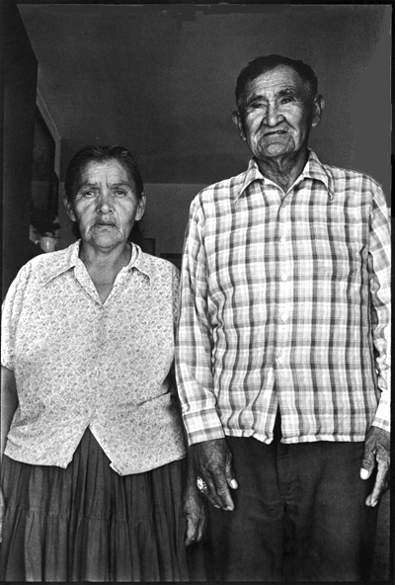
Navajo Miner

Slide 82
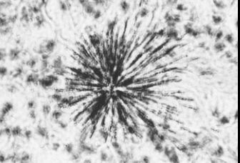
Alpha closeup

Slide 83
BCMA Report (1980)
Summary of doubling dose estimates for lung cancer in uranium miners:
  Archer (1967) 120 WLM
  Hewitt (1980) Ontario 40-50 WLM
  Newfoundland 50 WLM
  Sevc (1976). ~50 WLM
  US EPA (1980). ~40 WLM
  Ellett (1980). 40 WLM
  BEIR-II (1972) 34 WLM
  BCMA (1980) NIOSH & Sevc 19-20 WLM
  BEIR-III (1980). 12-17 WLM
  Axelson (1980) 2 WLM
  The lifetime incidence of lung cancer in males is 52.5 per thousand, The doubling dose from exposure to radon would be 40 WLM or less.
  Thus, there is a risk of 12.5 lung cancers per 1000 workers per WLM. The risk would be 4 times as high at today's permissible exposures.
  Compare this with the risk of accidental death in “safe” industries of 0.1 accidental deaths per million workers per year!

Slide 84
Radon Progeny (chart)
Although radon is a gas . . .

Slide 85
Radon Progeny (chart)
Although radon is a gas . . .
its byproducts are solids and
lodge in the lungs . . .

Slide 86
Radon Progeny (chart)
Although radon is a gas . . .
its byproducts are solids and
lodge in the lungs . . .
. . . in fact 85% of the lung dose
is from alpha-emitting polonium

Slide 87
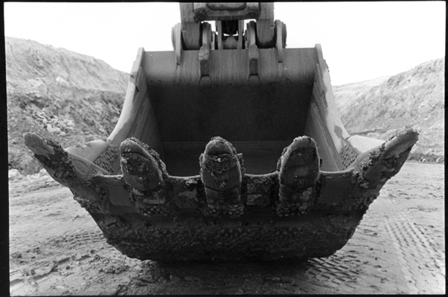
Uranium Shovel

Slide 88
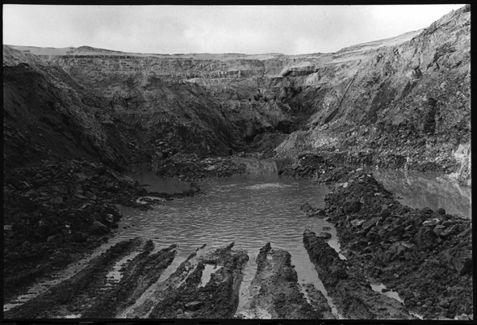
Key Lake Mine

Slide 89
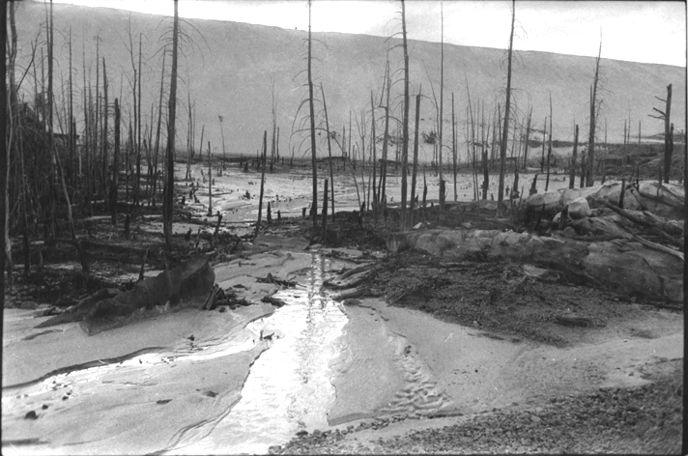
Stanrock Tailings

Slide 90
Uranium Decay Chain

Slide 91

Uses of Uranium

Slide 92

Fuel bundle in hand

Slide 93

Radionuclides in Environment

Slide 94

Empty Spent Fuel Pool

Slide 95

Dry Storage at G-1

Slide 96

Messy Shaft

Slide 97

Thermal Pulse

Slide 98

Radioactive Inventory

Slide 99

10 Million Years
source: Ontario Royal Commission on Electric Power Planning (1978)
The toxicity of
irradiated CANDU fuel
over a period of
ten million years

Slide 100
10 Million Years
source: Ontario Royal Commission on Electric Power Planning (1978)
The toxicity of
irradiated CANDU fuel
over a period of
ten million years
This graph represents the
irradiated fuel produced in a
single year by one CANDU.
The minimum amount of
water needed to dilute
this waste is about the
same as the amount of
water in Lake Superior.

Slide 101

Ball of Plutonium

Slide 102

Fission schematic

Slide 103


Slide 104

Chalk River

Slide 105

ZEEP Reactor

Slide 106


Slide 107

Hanford Tanks

Slide 108
Tritium (Hydrogen-3)
• Radioactive isotope of hydrogen (with 2 extra neutrons)
• Produced in large amounts from heavy water in CANDUs
Released in the form of liquid water or water vapour
Levels of tritium in Great Lakes is measurably growing
Intake by inhalation, ingestion, and through the skin
Crosses the placenta, can cause teratogenic effects
DNA especially sensitive, can cause genetic damage
Permissible levels in Canada highest in the world

Slide 109
Carbon-14
• Radioactive isotope of carbon (2 extra neutrons)
Released in the form of CO₂ and radioactive dust
Produced in large amounts by activation of nitrogen
Six thousand year half-life means global accumulation
Enters into all organic molecules (organically bound)
DNA especially sensitive, may cause genetic damage
Permissible levels in Canada highest in the world

Slide 110
Tritium (Hydrogen-3) and Carbon-14
• Prodigious amounts produced by CANDUs
Both pure beta emitters (no gamma at all)
Both very low energy (short track radiation)
Do not bio-concentrate in the food chain
Long half-lives leads to environmental build-up
Essential constituents of organic molecules
Reproductive risks exceed cancer risks

Slide 111

Radwaste Barrels

Slide 112

Radwaste at Bruce

Slide 113

Radioactive Pipe Burtial

Slide 114

Radwaste Incinerator

Slide 115

Face of CANDU – 2

Slide 116

Fuel Bundle in Face

Slide 117

Full Spent Fuel Pool
Notes:
Because of the heat generated by each intensely radioactive fuel bundle they cannot be stacked in close proximity and must be cooled by circulating water.

Slide 118
Dry Storage at G-1

Slide 119

Silos at Lepreau – side view

Slide 120
Messy Shaft

Slide 121

Neat shaft

Slide 122
OECD Data
60
50
40
People
30
20
10
0
    Nuclear waste generated in kilograms per thousand people.
    Source: OECD environmental data 1999

Slide 123
Thermal Pulse
. . . it takes 70,000 years for temperatures to return to normal

Slide 124

Pu-238 decay timeframe

Slide 125

Cycle? Or Chain?
The Nuclear Fuel Cycle?
or
The Nuclear Fuel Chain?

Slide 126

The Full Fuel Cycle

Slide 127

when a neutron
strikes a non-fissile
atom of uranium-238
two beta particles are given off
and an atom of plutonium-239 is created

Slide 128

Ball of Plutonium

Slide 129

Madonna of the Glovebox

Slide 130

B-Reactor

Slide 131

B-reactor Canyon

Slide 132

Plutonium Life Span

Slide 133
Chalk River

Slide 134
ZEEP Reactor

Slide 135

ZEEP sign close-up

Slide 136
ZEEP plaque text

Slide 137

Windscale plant

Slide 138

Cooling Coils

Slide 139
Maids of Muslyumovo

Slide 140



Slide 141

Fuel bundle in hand

Slide 142

Splitting of the Atom
Notes:
The nucleus of the uranium atom can be split apart, releasing energy. This splitting is called “nuclear fission.”
This is a Soviet monument to the splitting of the atom. In the foreground stands the father of the Soviet atomic bomb, Vladimir Kurchatov.
The monument depicts the atom at the instant it gets split. The hemispheres represent the broken pieces of the atom, and the semicircles surrounding each hemisphere represent the waves of energy released when the atom splits. When trillions of uranium atoms get split all at once, the energy released yields the explosive power of an atomic bomb.
The broken pieces of the atom are no longer uranium; they are new elements called “fission products.”There are hundreds of them, most of them not found in nature.
These fission products do not disappear. After an atomic explosion they fall to the ground (“fallout”). These same fission products are present in irradiated nuclear fuel.

Slide 143

Closup of 1931 doc

Slide 144

Gaertner Pit

Slide 145

Rad-sign Closeup

Slide 146

Uranium Mill

Slide 147
Hiroshima Buddha

Slide 148
Fat Man and Little Boy

Slide 149


Slide 150

CANDU schematic

Slide 151

Enrichment plant

Slide 152

Small Wonder

Slide 153

Fuel Pellet in hand

Slide 154

Bjarnie Paulson

Slide 155

Joyce Carradi

Slide 156

Becquerel reindeer

Slide 157

Fission schematic
U-235

Slide 158
Fission schematic

Slide 159
Fission schematic

Slide 160
Radioactivity and Human Health
featuring the photographs of Robert Del Tredici
Canadian Coalition for Nuclear Responsibility
www.ccnr.org
Notes:
The Canadian Coalition was

Slide 161

Hanford – Port Radium

Slide 162
Notes:
Radon gas is being transported over large distances. New radon is continuously formed by decay of radium-226; some fraction of the radon is being released and dispersed over large areas.

